Slide 1
Face Morphing
Names: Qiuhua Wu, Xinyi Jiang, Yue Zhuo
Group number: #2

Slide 2
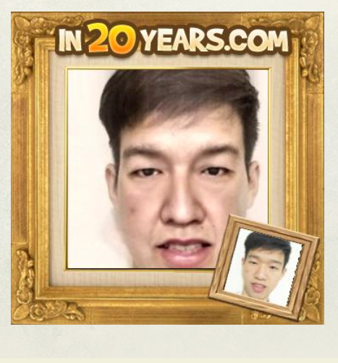
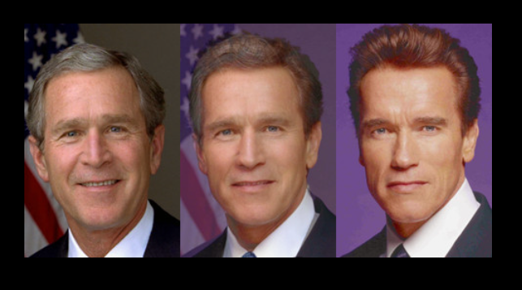
Introduction/background
Face Morphing can be used in:
Movies
Anime
Apps
For Fun

Slide 3
Problem formulation
There are mainly three steps to morph a face to another, Landmark detection, Triangulation and Affine transform.
Based on this, our group have successfully done the face morphing step by step.
We will also introduce our project by these three parts to show our results.

Slide 4
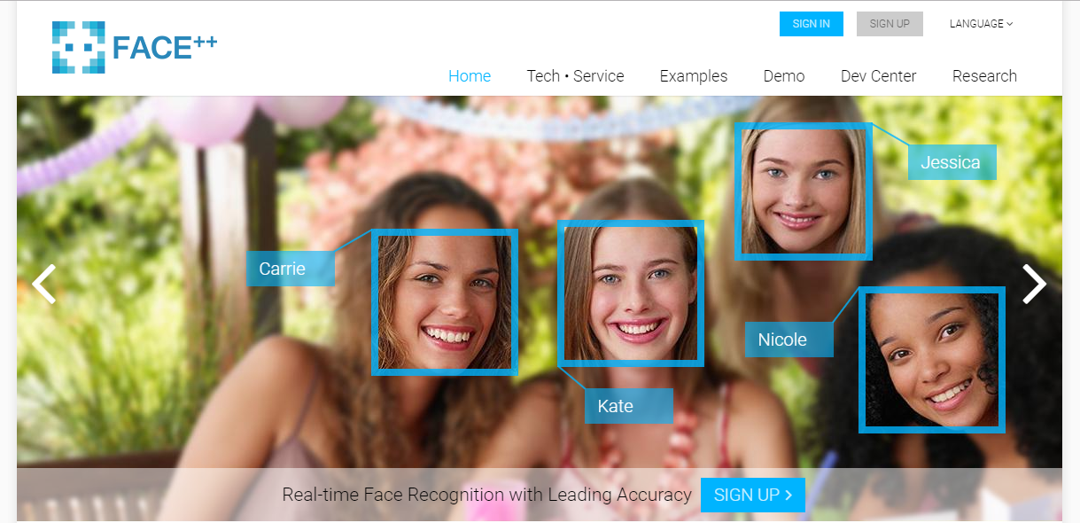
Get Landmark introduction
www.faceplusplus.com

Slide 5
Get Landmark steps
Post the image file to api ‘http://apicn.faceplusplus.com’
Get the landmark information back in JSON file
Parse JSON file in Matlab and get the Landmark points of face

Slide 6
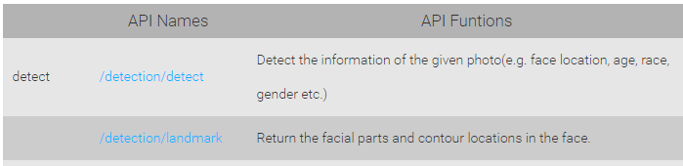
Get Landmark api docs

Slide 7
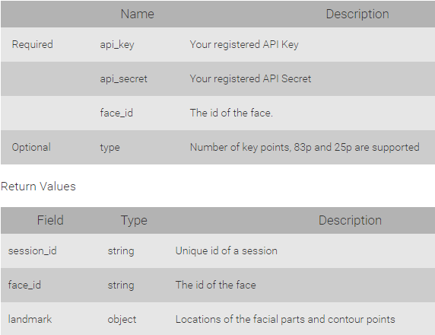
Get Landmark api docs

Slide 8
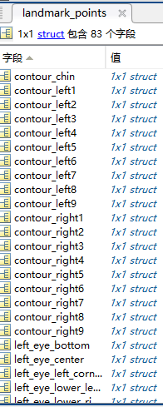
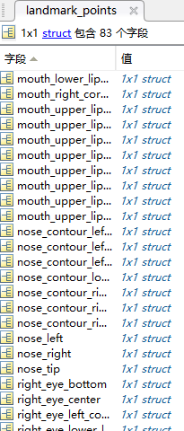
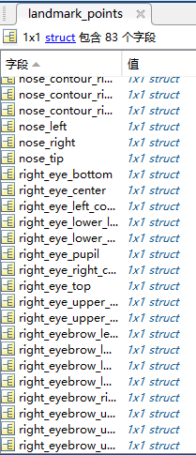
Get Landmark examples

Slide 9
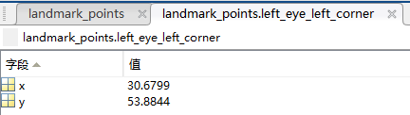
Get Landmark examples

Slide 10
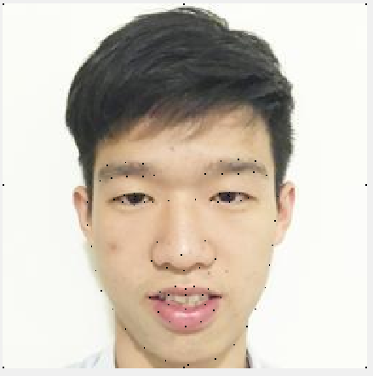
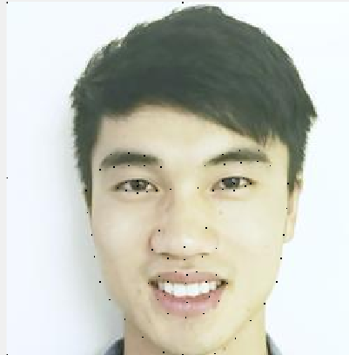
Get Landmark examples

Slide 11
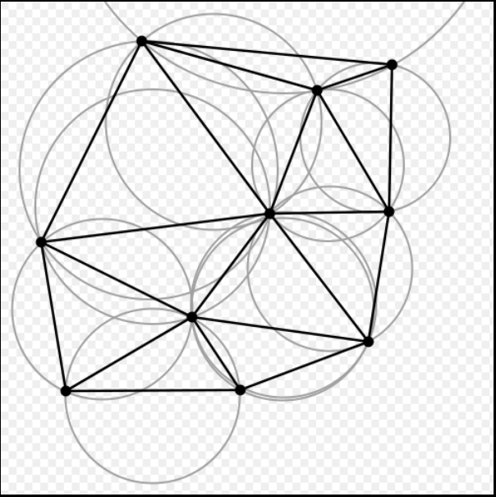
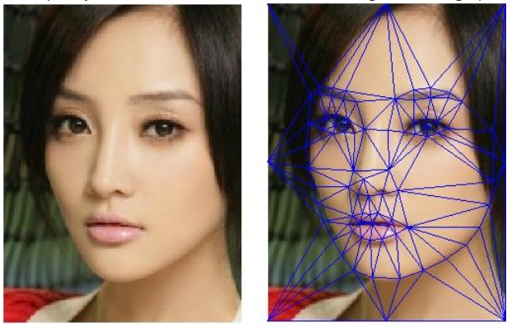
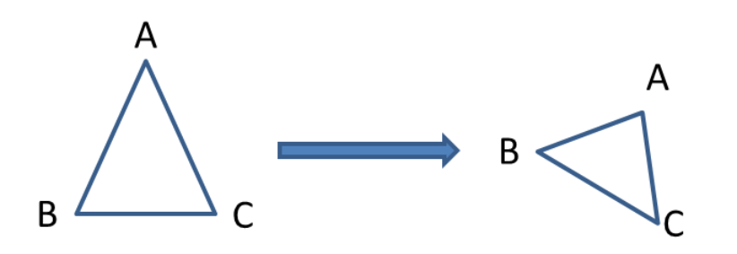
Experiments and results
Triangulation
Delaunay Triangulation

Slide 12
Fusion
1. Create medium location of triangle vertexes (weighted average)
2. Create a all zero image waiting for assigning values
3. Compute transform matrix of medium location to original image and targeted location
4. Using this transform matrix to get where are the corresponding points of zero image on original and targeted images
5. assign corresponding value to each pixels of zero image

Slide 13
Fusion
1. Create medium location of triangle vertexes (weighted average)
2. Create a all zero image waiting for assigning values
P = 0.1 : 0.05 : 0.9;
medLM(i, 1) = P(j)*(targetLM(i, 1) - originalLM(i, 1)) + originalLM(i, 1); % x of the medium landmark
medLM(i, 2) = P(j)*(targetLM(i, 2) - originalLM(i, 2)) + originalLM(i, 2); % y of the medium landmark
medG = zeros(256,256, 3)

Slide 14
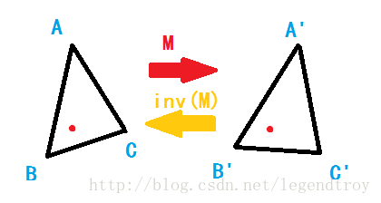

Fusion
How to compute the transform matrix of triangles:
A(x1,y1,1);B(x2,y2,1);C(x3,y3,1)
A’(x1,y1,1);B’(x2,y2,1);C’(x3,y3,1)
T1=$\left[\begin{matrix}x1 & x2 & x3 \\ y1 & y2 & y3 \\ 1 & 1 & 1\end{matrix}\right]$, T2=$\left[\begin{matrix}x1′ & x2′ & x3′ \\ y1′ & y2′ & y3′ \\ 1 & 1 & 1\end{matrix}\right]$
Assume M is transform matrix,
$$T1×M=T2$$
So we can compute M from
$$M=T2×{T1}^{−1}$$

Slide 15
Fusion
3. Compute transform matrix of medium location to original image and targeted location
for k = 1: size(TRI, 1)
mX = medLM(TRI(k, :), 1);
% x of medium landmark of no.k triangle
mY = medLM(TRI(k, :), 2);
% y of medium landmark of no.k triangle
m0 = [mX, mY, ones(3, 1)]'; % build coordinate matrix for each medium triangle
m1 = [originalLM(TRI(k, :), 1), originalLM(TRI(k, :), 2), ones(3, 1)]'; %build coordinate matrix for each original triangle
tran1 = m1 * m0^-1; % counting transform matrixes which transform medium coordination to original ones

Slide 16
Fusion
4. Using this transform matrix to get where are the corresponding points of zero image on original and targeted images
5. assign corresponding value to each pixels of zero image
pos1 = tran1 * [x; y; 1];
% get the coordination of referenced points of original image
Similarly we can get the corresponding location of targeted image pos2
Then adjust pos1 and pos2 to integer location
p1x=round(pos1(1,1)); p1y=round(pos1(2,1));p2x=round(pos2(1,1));p2y=round(pos2(2,1));
medG(x, y, :) = (1-P(j)) * originalG(p1x,p1y , :) + P(j) * targetG(p2x, p2y, :);

Slide 17
Results
Animation of face morphing
Each frame is each medium fused images we gained last step

Slide 18
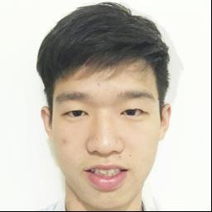
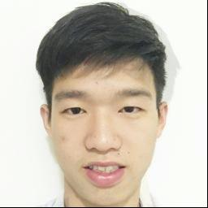
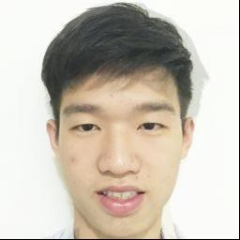
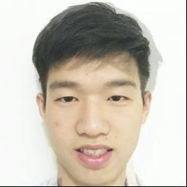

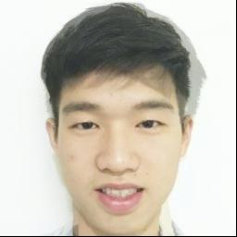
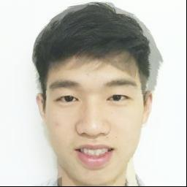

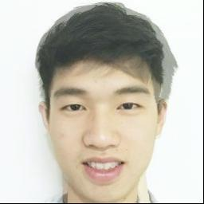
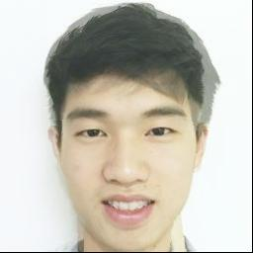
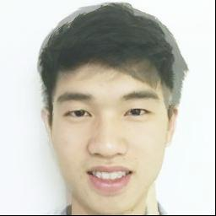
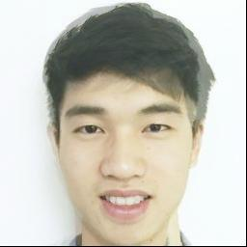
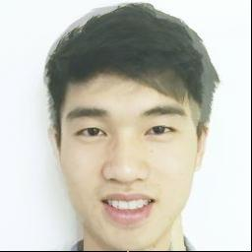

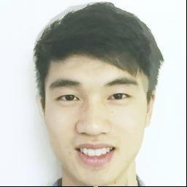
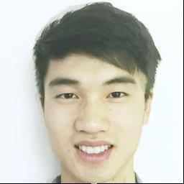
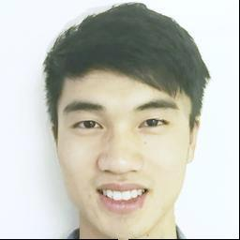
Results

Slide 19


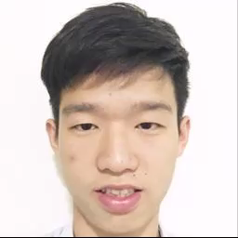
Results

Slide 20


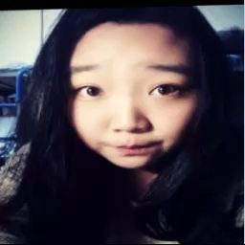
Results

Slide 21
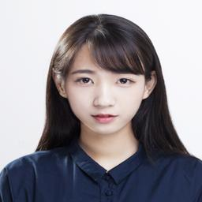
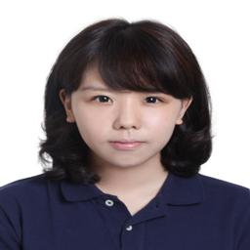
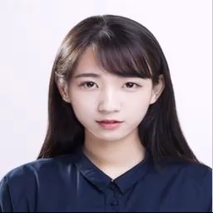
Results
Source: https://tuchong.com/55422/12493071/
http://www.starphotos.cn/plus/view.php?aid=400

Slide 22
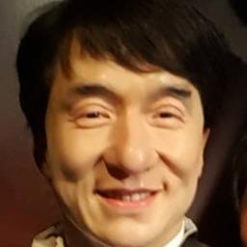
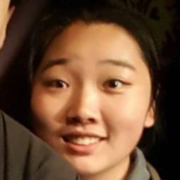
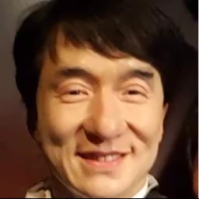
Results

Slide 23
Future directions
Speed
Not only face but the whole image
Not only weighted fusion, but the bilinear interpolation.
5. assign corresponding value to each pixels of zero image
medG(x, y, :) = (1-P(j)) * originalG(p1x,p1y , :) + P(j) * targetG(p2x, p2y, :);

Slide 24
Information Cited
https://github.com/t0nyren/piecewiseAffine/blob/master/README.md
http://blog.csdn.net/a809146548/article/details/50681961
https://en.wikipedia.org/wiki/Morphing
http://www.faceplusplus.com
http://blog.csdn.net/pdcxs007/article/details/8865660
http://www.soopat.com/Patent/201310601251

